Slide 1

Hack Day 2023

Slide 2
Team CAWS
Context Aware WLAN Security

Slide 3
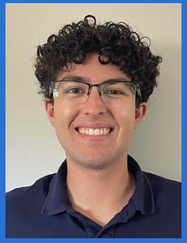
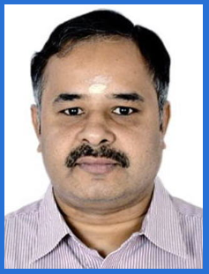

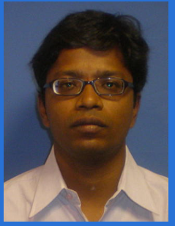
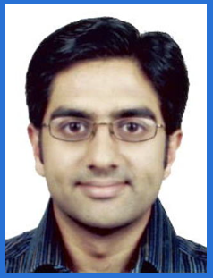
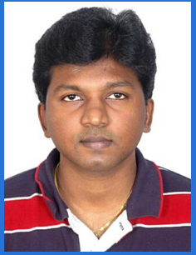
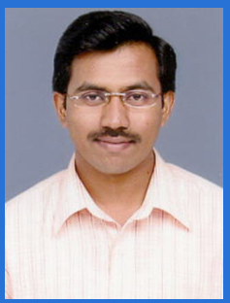
Team CAWS
Gokul BKS
Wireless, AI/ML Expert
Dev Team, Bangalore
Alberto Valdes
Cyber Security, Python Expert
Dev Team, Meraki, SFO
Srihari Bhavanasi
Wireless, Python Expert
Dev Team, Bangalore
Srinivas Gadamsetty
Wireless, RRM Expert
Dev Team, Bangalore
Ravi Divecha
Wireless, AI/ML Expert
Dev Test Team, Bangalore
Jegan Manoharan
Wireless, Security Expert
Dev Team, Bangalore
Vijay Kothamasu
Wireless, Telemetry Expert
Dev Team, Bangalore

Slide 4
Hack Day
The ‘‘Problem’’ !!
Wi-Fi Adoption is ever growing in the Enterprise Networks, use-cases are increasing. Threats and its complexity of detection is increasing.
Every use-case is unique, existing WLAN Security Policies are static. Static policies can not cover all use-cases and attacks.
Existing static WLAN Security Policies can’t handle all kinds of use-cases

Slide 5
Hack Day
The ‘‘Proposal’’ !!
WLAN security policies should be dynamic.
Decide security policy - Based on the context of the use-case!
What is the Context: (4Ws) - Who! What! Where! When!
GOAL: Enterprise Security Policy should
(1) Not be a burden to legitimate users – Increases the productivity (On-Boarding is quick)
(2) Challenge illegitimate access – Control threats at inception

Slide 6
The ‘‘Context’’ !!
Hack Day Pitch
Context | Description | Usual | Security Factor
Who? | Who is joining the Network? | Employee | 0
 |  | Partner | 1
 |  | Guest | 2/Web-Auth
When? | When is the user joining the Network? | Usual time | 0
 |  | Unusual time | 1
What? | What device is used to join the Network? | Cisco managed | 0
 |  | Un managed (BYOD) | 1/Posture
Where? | From where user is joining the Network? | From office | 0
 |  | Remote (Ex: WFH) | 1
Context of the use-case, customizes the Security Policy to achieve the Goal

Slide 7
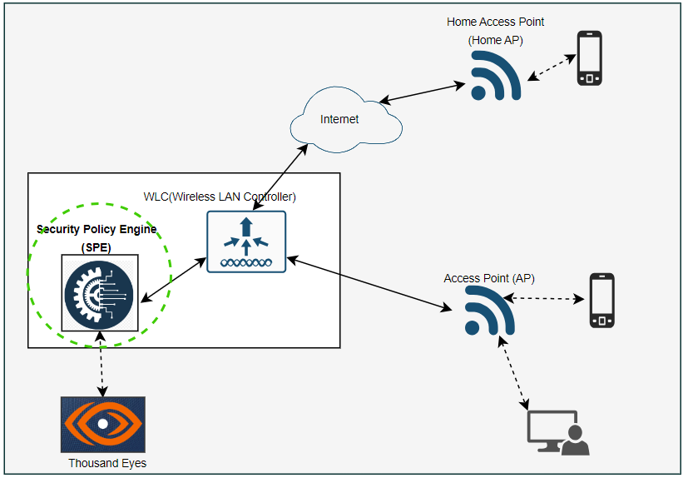
Scope of Implementation in Hackathon!!
Hack Day Pitch
Design of the Logic for deriving Security Policies based on the Context parameters
Implementation of Security Policy Engine (SPE) – ML Based!!
Mimic data coming from “Thousand Eyes”

Slide 8
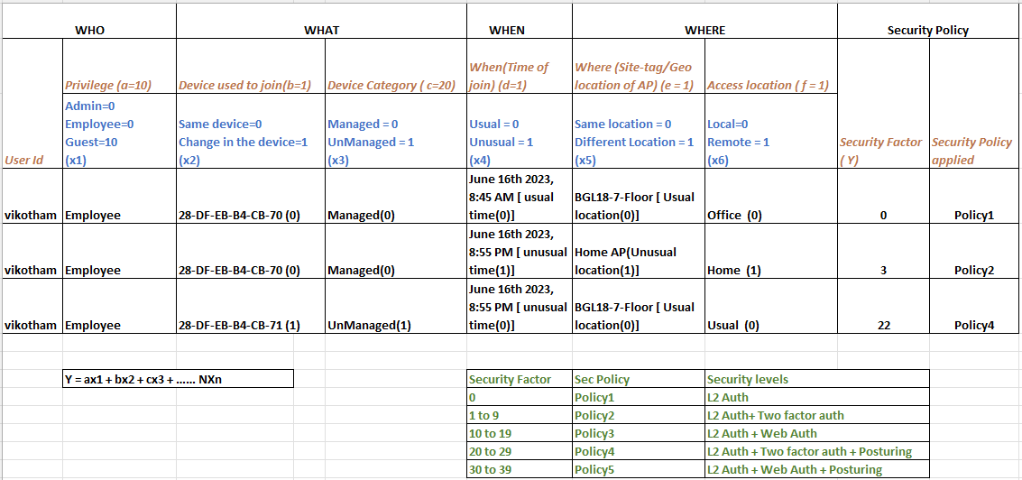
Algorithm – Deriving Security Policies based on Context!!
Hack Day Pitch

Slide 9
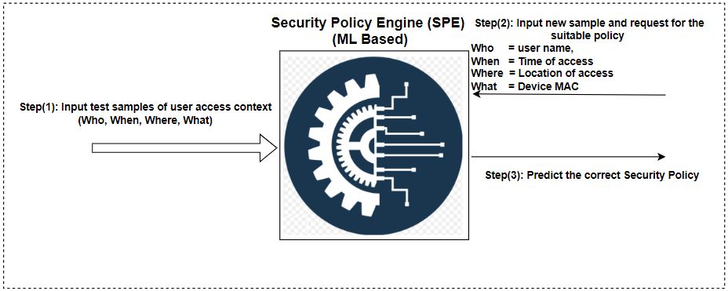
Security Policy Engine (SPE) – ML Based!!
Hack Day Pitch
Extracted 200K samples of user access context from the logs (EFT Production Network logs) and assigned Security Policy.
Implemented ML Engine based on Decision Tree Algorithm (Supervised Learning).
Trained ML Engine with 80% of the samples and tested on the remaining 20% samples.

Slide 10
Hack Day Pitch
Demo!

Slide 11
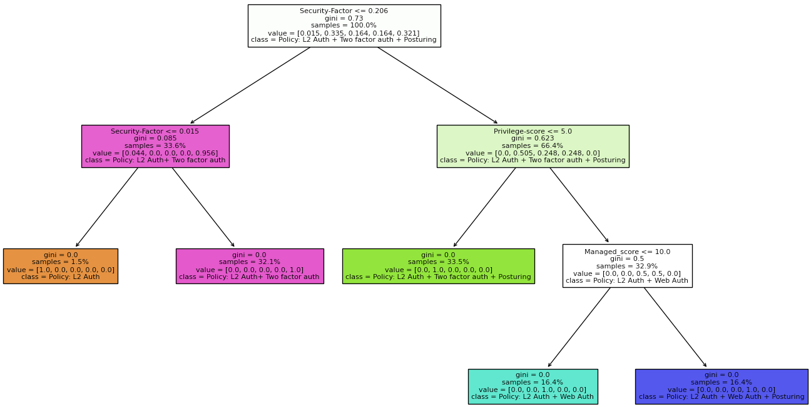
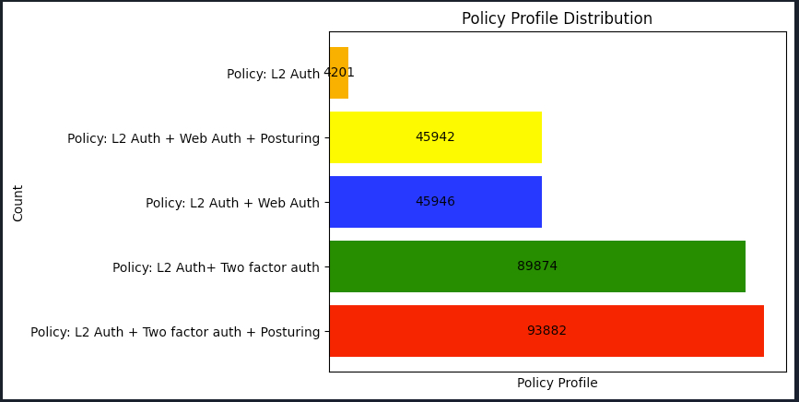
Security Policy Engine (SPE) –ML Based!!
Hack Day Pitch
Decision tree generated from:
Post Learning charts from:

Slide 12
Hack Day Pitch
What Next!
Explore integration with “Thousand Eyes” to get live Network data, so that run time attack patterns can be detected through ML Engine and select the suitable Security Policy(CoA).
Extend context aware Security policy to “Run Time” access apart from on-boarding.
Reach out to PMs to productize the feature, this is a differentiator to competition and very relevant to many of Cisco customers.
Publish paper and possible CPOL.

Slide 13
Hack Day Pitch
Thank you!

